Slide 1
VLSFO, A Snapshot into then, now and next
June 21
Notes:
Hello and welcome from Singapore. My name is Chris Turner and I am the Manager of Bunker Quality and Claims at Integr8 Fuels.
I would start by sending my best wishes to you and your families in what remain trying times for us all.
CHANGE SLIDE (25 secs)

Slide 2
GLOBAL
FOOTPRINT
New York
1 Trader
LONDON
8 Traders
Hamburg
2 Traders
shanghai
3 Traders
Dubai
9 Traders
A truly global presence with twelve offices in the main bunkering hubs
Local presence is a must in this industry, in order to develop key relationships with customers and suppliers
Houston
5 Traders
Oslo
3 Traders
Mumbai
3 Traders
Tokyo
1 Trader
Orlando
1 Trader
Athens
5 Traders
Singapore
18 Traders
Notes:
So onto today, Firstly - I will make a small introduction to Integr8, Ten years ago, Integr8 commenced its operations on the back of Navig8’s bunker requirements, to become today one of the top five bunker trading companies in the world
Integr8 are currently trading in the region of 5.5 Million tonnes of bunkers per annum, with a turn-over of $2.7 Billion Dollars a year and you will see from the slide that this is being helped by our TRULY global presence with twelve offices in the main bunkering hubs
As for todays presentation - it is entitled VLSFO (a snapshot) into Then Now and Next - where we will look at how we have got to this point and also look at challenges we continue to face - and may have to deal with in the future.
1 min 10 secs

Slide 3
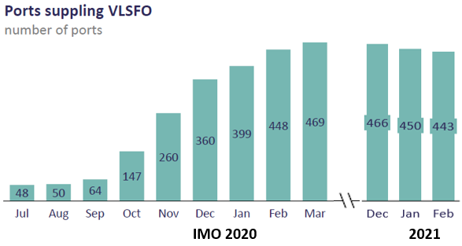
IMO 2020
Nov 2019
THE CHANGE-OVER
Integr8 saw a sharp uptick of VLSFO orders and requests for HSFO Debunkering during the month of November 19. Sulphur claims were prevalent in the early days probably as a result of cross-over
Jan 2020
AVAILABILITY?
A little over 16 months ago the Industry faced one of the biggest challenges it had ever faced
Despite Initial tight availabilities VLSFO supply ramped up rapidly to more than 400 ports worldwide, an increase of 50% from Nov 19, Infrastructure lagged but caught up & most challenges overcome. FONAR’s quickly fell away after an initial spike supporting a relatively seamless changeover.
Notes:
From a Quality point of view - When a specification does change Its quite normal for this to be accompanied by a spike in claims and IMO 2020 was no different – this perhaps as a result of contaminations or compatibility issues (either within the supply chain) or even unrepresentative samples (previous residues in samplers etc) It was good to note that these quickly settled down (as did the initial issues for availability)
And turning to Avails – problems were tracked initially by FONARs which quickly became less frequent by the end of January to the current level of no more than a handful of notifications a month
This can be seen by Integr8 data which identified ports supplying VLSFO quickly reached 400 in January 2020- finally reaching 469 worldwide in March 2020 and remaining fairly constant since then.
1 min 25

Slide 4
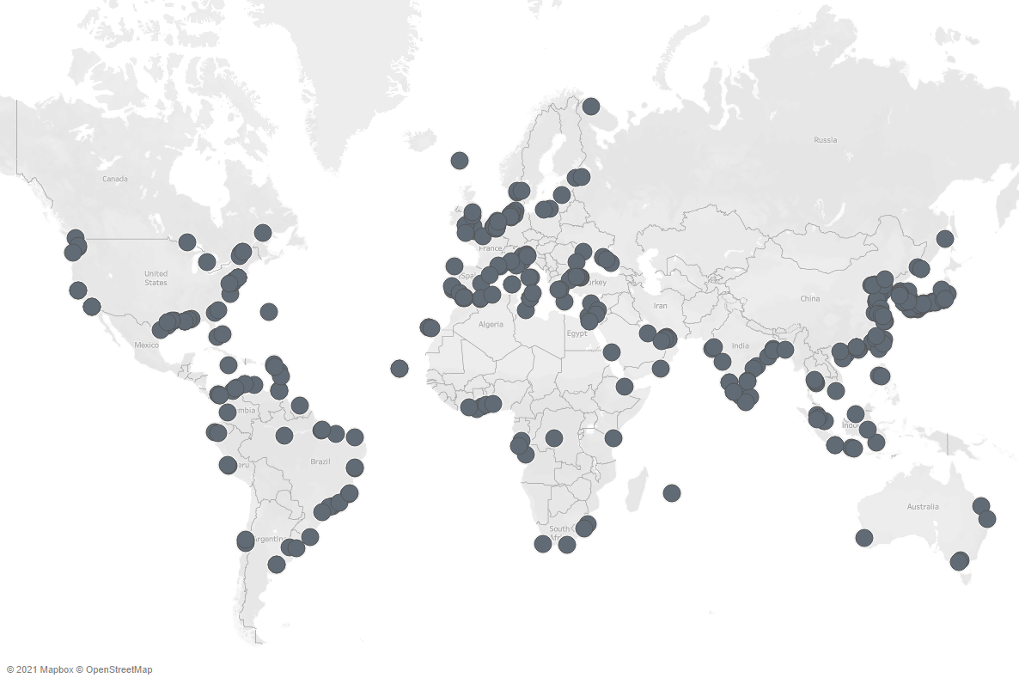
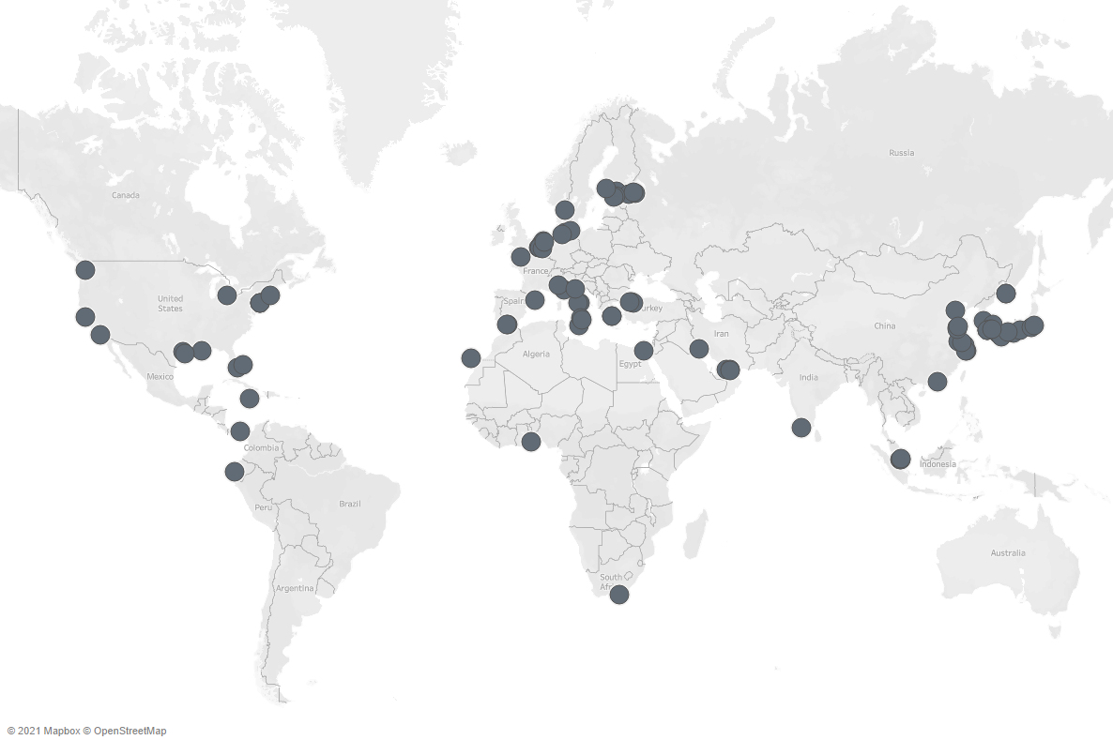
IMO 2020 & DIVERSITY IN THE BUNKER MARKET
PORTS SUPPLYING VLSFO -MARCH 2021
PORTS SUPPLYING HSFO - MARCH 2021
VLSFO SUPPLIERS
HSFO SUPPLIERS
GLOBAL SHIPOWNERS
⁺450
⁺150
1000s
Notes:
And this slide visualises avails as of today for both VLSFO and HSFO and you will see that VLSFO is now readily available however post Imo 2020 HSFO supply has retreated to strategic parts of the world where tankers (which generally govern demand) pass through.

Slide 5
VLSFO
TRENDS
VLSFO
Effects of targeting Sulphur when blending VLSFO
Significant variance of Densities create an important risk when considering Vessel Intakes and also onboard set up of equipment
Variances In Viscosity require adjustment to settings onboard vessels for Purifiers and Injection.
The targeting of Sulphur has resulted in profound changes to the Fuels that are commercially available
DENSITY
VISCOSITY
Notes:
And… now moving onto VLSFO and a quick comparison with HSFO and some of the challenges these key differences can bring.
The simplest place to start is that VSLFOs are far more varied than HSFO, this due to Sulphur being the key blend target rather than Density & Viscosity in the case of HSFO.
You will see from the distributions on the slide (& the red boxes) how VLSFO is much more varied with Densities as low as 0.86 Kg/Ltr, predominantly between 0.90 and 0.96 Kg/Ltr with some closer to 0.99. HSFO Densities on the other hand are concentrated from 0.96 to 0.99 kg/ltr
This brings two important considerations to mind, firstly the need to ensure you know the accurate density for intake purposes given you could have up a 16% relative difference and secondly the need for the correct density to be transmitted to the vessel for equipment set up purposes.
Moving onto Viscosity (& the blue boxes), you will see that the Average Viscosity is much lower than that of HSFO with lows of a quite amazing 5cSt up to normal levels of 380cSt however Viscosity tends to be concentrated less than 150cSt - this again very different to HSFOs which tend to be 250 cSt and above & concentrated around 300-350cSt.
Again it is important to know the viscosity for purification and Injection set up onboard.
4.00 Mins (total)

Slide 6
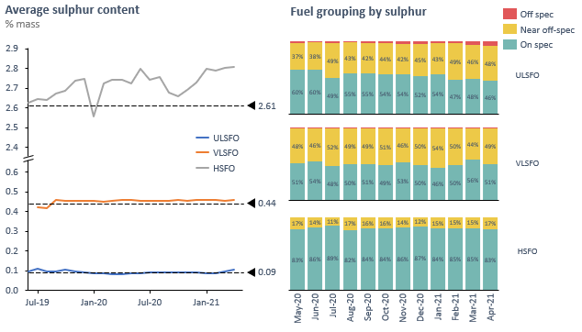
VLSFO
TRENDS
Sulphur Content
Sulphur Content averaging below 95% confidence limits worldwide but its a different story in the bunker hubs
Notes:
And moving to Sulphur – in general compliance has been good – barring one of two early challenges
This can be seen from the global average which has stayed stable at 0.44 %wt however we are seeing signs of Sulphurs closing in on the 0.50% limit especially in blend hubs such as ARA and Singapore.

Slide 7
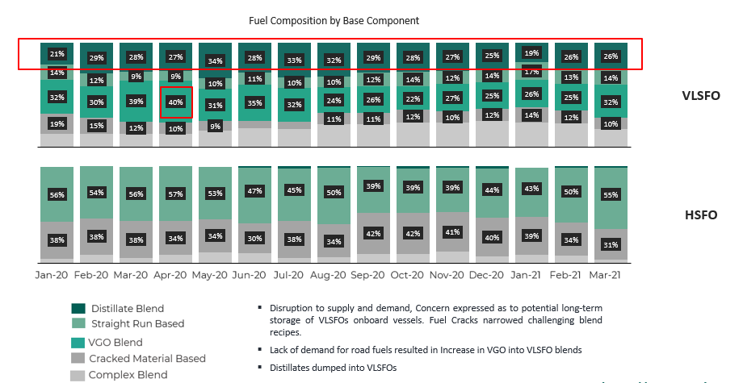
VLSFO
TRENDS
Fuel Composition by Base Component
Q2 2020
COVID-19
VLSFO blends have been affected by the prevalence of blend components based on market forces
Notes:
Moving a little deeper into VLSFO trends - It is also important to understand some of the unexpected consequences of COVID 19.
One of the first alerts raised was the possibility of vessels storing fuels for far longer than anticipated resulting in degradation . Thankfully this did not result in too many issues from our perspective but the storage temperatures of the “goldilocks” fuels (as they have been so eloquenty christened) remains important to carefully manage – Like the porridge in the story, not too hot, not too cold but just right…
Another consequence was the lack of demand for road fuels challenging the bunker space with VGO flowing (or not as the case may be given its Pour Point) into the blends instead of into the cat cracker – you can see this from the data which shows VGO based blends (ie noted to have high PP) maxing out in Q2 at around 40% (using our own best quality fit data from thousands of samples) before falling back given the recovery in the demand for diesel and gasoline for example
Thirdly Distillates are far more prevalent in VLSFO than HSFO (as can again be seen from the data) but arguably EVEN more distillate flowed into VLSFO given the narrow price spread between MGO and VLSFO we saw during 2020.

Slide 8
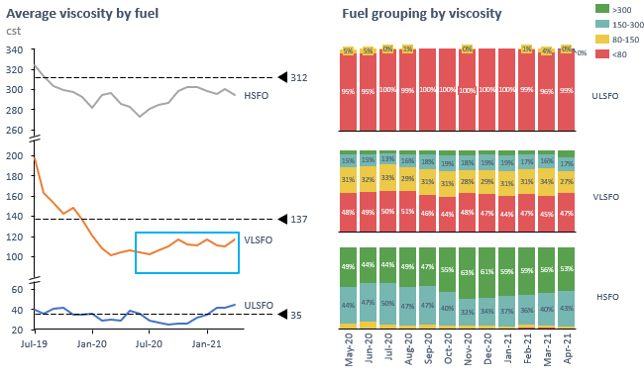
VLSFO
trends
Viscosity Trends
[Integr8]
Viscosity is routinely much lower than HSFO and often
less than 100 cst
Notes:
And we can see this as we track significantly lower viscosities in VLSFOs across Q1 and Q2 of 2020.
These how since recovered as you will see from the blue box on the screen.

Slide 9
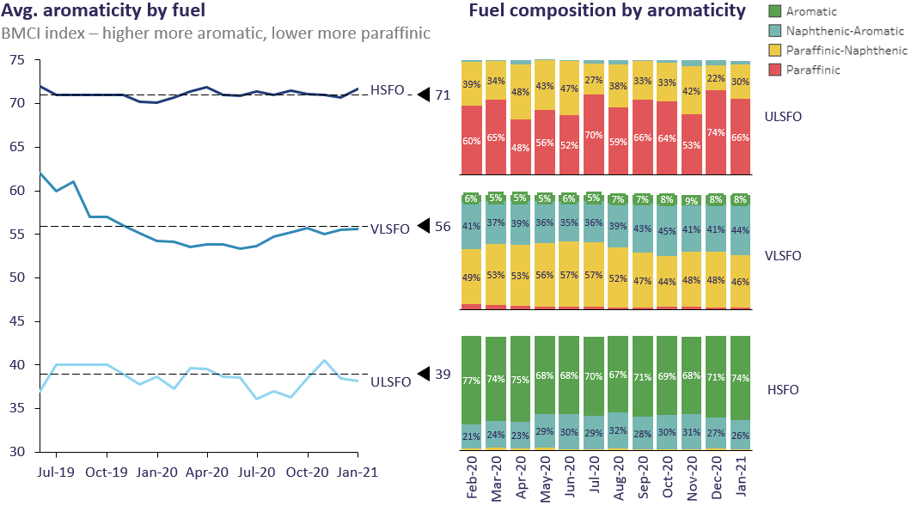
VLSFO TRENDS
Compositional Changes
[BMCI]
VLSFOs are more varied in composition and more Paraffinic in nature than HSFO
BMCI Bureau of Mines Calculation index based on CCAI and Viscosity (Paraffinic <29 Napthenic >29 <57 Aromatic >57)
Notes:
The variances in blends also have a significant effect on the composition of VLSFO when compared to HSFO and these trends can be tracked using aromaticity and specifically a calculation known as BMCI
BMCI Bureau of Mines Calculation index based on CCAI and Viscosity WHICH DEFINES (Paraffinic Fuel <29 Napthenic Fuel >29 <57 Aromatic Fuel >57
You can see that the BMCI of VLSFO is much less than HSFO with a BMCI of 56 compared to 71. This means that it is more Paraffinic.
Globally for VLSFOs - Paraffinicity bottomed out in the summer of 2020 ( due to the presence of VGO ) and since then has been trending up to an average of 56 globally (Naphthenic) much less aromatic than HFO which remains fairly constant around a BMCI of 70
3 min 45

Slide 10
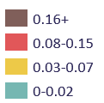
NOTABLE
OCCURENCES
TSP Levels
May 2020
TSP SPIKES IN ARA
Claims had been sporadic to this point. Alleged difficulties generally revolved around change-over practices but in early May ARA was significantly affected by TSP issues
VSLFO qualities have generally been “ a storm in a teacup” however there have been some notable exceptions
Notes:
Moving onto Notable occurrences and specifically quality issues.
Its generally agreed that the warnings that were aired as to vlsfo qualities have generally been “ a storm in a teacup” HOWEVER it would be remiss to not state that there have been some notable exceptions - one of which was a large spike in elevated TSPs in ARA around May 2020
Paradoxically however – when looking at the prevalence of TSP issues by area (and despite these remaining generally sporadic globally) it is noteworthy that ARA, (the blend pool with the most aromatic blends ) also have the highest prevalences of off spec TSP which isn’t what you would expect as a higher BMCI would normally provide for a better stability reserve. This still remains a mystery (as do the occasional bumps in the road even now) although the complexity of blends (and the supply chains) themselves are greater in ARA than Fujairah ( an example of a better performing hub)
8 mins 30 approx.

Slide 11
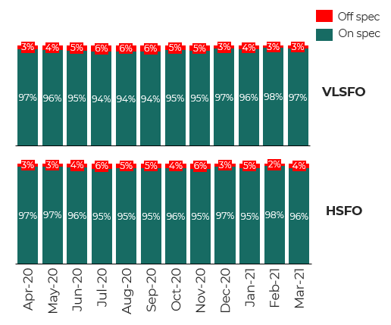
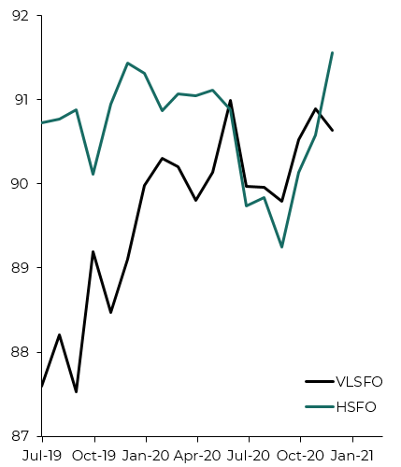
OFF SPEC OCCURENCES & THE EVOLUTION OF FUEL QUALITY
Average Quality by Fuel
Integr8 Calculated Index
Fuel Grouping by On & Off spec
Quality index (which assesses critical parameters and their proximity to specifications.
Notes:
Which takes me to the next slide, which is all about the latest off-spec occurrences and how the quality of VLSFO has evolved. As you can see on the graph on the left, through Integr8s calculated quality index, scoring fuels on critical parameters and their proximity to specification limits, VLSFO quality quickly improved from a level of 88 to almost parity with HSFO. As the year went by and producers gained more experience with VLSFO, the number of off-specs started reducing.
And looking at the stacked bar chart on the right, it is no more likely that an off-spec occurrence is alleged for VLSFO than HSFO.
As for types of claims - I would also add that the distribution of VLSFO off specs is very much centred around TSP and also Sulphur which account for around 75 % of all issues. The remaining claims are made up of predominantly water claims and other minor Infractions
It would be worth debunking one particular myth at this time in that despite the sensational stories in the press there remains no evidence of wholesale blending of Aviation fuel in Bunkers – as this would have reduced flash point significantly – and we havent seen this.
1 min 48 (10 min 30 approx.)

Slide 12
NOW
STABILITY & COMPATIBILITY
NON HOMOGEOUS FUELS
The sheer variance of VLSFOs from port to port continue to challenge all stakeholders across the Industry
In addition to well known and documented Compatibility problems questions remain as to the long-term stability of VLSFO not helped by inconsistent advice being provided to end users which may result in further fuel degradation
Low viscosity and higher temperatures may result in fuels becoming non homogenous across the supply chain. This should result in a rethink for claims scenarios
NON COMPLIANCE
AGGRESSIVE BLENDING
Whilst levels of non compliance remain low globally blend economics tightening pushing Sulphur Level closer to 0.50% in tank in Blending Hubs. Documentation remains problematic
Relationships between Pour Point and Viscosity or Density and Viscosity as a result of available blend components. Data driven purchasing essential
Notes:
So this brings us to the present day – and where we are now !
STABILITY AND COMPATIBILITY
Our aptly termed Goldilocks fuels continue to challenge us up and down the supply chain not least with regard the temperature that they should be stored at. Specifically here I will raise on point of contention which I have experienced and that is the sheer variance of advice being provided from one test house to another.
It is true VLSFOs are waxier but we must balance the temperatures of storage and purification to the animal overall and not just the wax as we may create a far larger problem if the fuel is overheated and falls apart as a result (becoming thermally unstable). It is true the knowledge of WAT, WDT and the like are useful to know but I remain concerned too much bias is given towards them from some quarters. After all it is the first wax crystals detected (when cooling WAT) and last detected (when heating WDT).
NON-HOMOGENOUS FUELS
Thanks to the bigger variance between the density of the VLSFO and the particulate or molecule that may fall out. (Al Si, water, dirt etc) there is a far bigger possibility for a fuel to become non homogenous from refinery gate to engine inlet.
This generates the need for more quality control BUT may also bring some relief from some of the polarized claim positions currently being taken.
Let us not forget that a fuel which so readily allows Al, Si and Water to separate out will also be able to be efficiently settled and purified onboard - I would hope this may allow pragmatic view compared to the “its off spec remove it “ position which seems to be almost the first shot fired in a claim scenario these days
NON COMPLIANCE is of course a spectre we all want to avoid but given blend economics it is not too surprising that the envelope is starting to be stretched in some quarters in order to reduce the cost of the oil and increase profitability.
Lets also not forget the importance of the BDN and the need for it to be accurate and completed correctly. These too can create non-compliance
AGGRESSIVE BLENDING
We have seen some fuels with Viscosity as low as 5 cSt and Pour Point at the same time being 30 Deg C and this creates an impossible position for the Ch. Eng when trying to meet OEM requirements for Purification or Injection (which require 20cSt and 12cSt respectfully) as the settings needed to achieve this are impossible given the waxy nature of the fuel.
2 min 30

Slide 13
NEXT
TRACEABILITY
BLEND EVOLUTION
IMO 2020 and COVID-19 have challenged the “norm” in bunkering and don’t forget Carbon Reduction
COVID has challenged our way of working and may have changed the industry irreversibly
Pricing of components will continue to drive the evolution of VLSFO blends
SPECIFICATION CHANGES
CARBON REDUCTION
Amendments of ISO 8217 need to consider what is happening both commercially and onboard vessels
Drop in Biofuel Blends allow older tonnage to potentially be able to meet Carbon Reduction targets using biofuels without expensive retrofits
Notes:
And given these continued challenges, what may we face going forwards….
TRACEABILITY
Firstly COVID has provided a catalyst for the industry to work more remotely and with that move with the times technically. One such development is the use of electronic BDNs or documentation and this, combined with traceable and regulated measurements (such as in Sg) may negate many of the safety issues associated with Access and Egress and ultimately provide for efficiency savings too. Of course the Industry has some way to go to compete with the level of traceability that the aviation industry has , but I do not think we are too far away from a blockchain scenario where the end-to-end traceability removes many of the historic BDN inaccuracies or malpractice concerns.
BLEND EVOLUTION
Given the increase in crack between MGO and VLSFO It would not be entirely unexpected to see Sulphur climbing towards the 0.50% limit and infractions creeping up nor would it be unexpected to see water content increasing. Thankfully however as yet we have not seen wholesale evidence of obscure cutters making their way into the market – we can but hope lessons were learned in 2018
SPECIFICATION CHANGES
As already mentioned no one predicted a fuel could be sold as a 380cst RMG with a viscosity of 5cst yet it has come to pass. Commercially there is nothing to stop this but ultimately operationally such fuels can create huge challenges. Therefore minimum viscosity specs would be a sensible addition with table 2.
We also cannot forget that operational set ups have changed significantly with fuels no longer being purified at high temperatures (98 deg c) – due to lower viscosities) and this creates the argument that the TSP test (which uses 100 deg C) is not mirroring what we are actually doing onboard.
CARBON REDUCTION
Touching briefly on Co2 I want to raise awareness of the likely increase of biofuels in certain tonnages going forwards. Particularly for the older tonnage these may pave the way to meet Carbon Reduction targets without expensive retrofits (ammonia/methanol etc) and ultimately prolong the lifespan of the ship. This will need a change of specifications and tact in the industry in general given some of the recent GCMS alerts for exactly the components we will inevitably be blending.
CLOSE
15 mins approx.

Slide 14
Notes:
And that concludes my presentation – I hope this quick snapshot into VLSFO was of some use and it only remains to say Thankyou to the organisers for the opportunity to speak and I wish you and your families good health in the months ahead. Thank you.

